Slide 1


SUBMITTED BY – Rohit Choudhary Pratik Sanjay Abhishek Tiwari Saif Ejaz Sristi
PROJECT WORK
ON
WEATHER PREDICTION
SUBMITTED TO –
Mr. Joyjit Guha Biswas
(DEVELOPER)

Slide 2
INTRODUCTION
The project predicts the weather of future dates based on the previous data using concepts of machine learning.
Regression model takes the data of Delhi’s climate from 1997 to 2017 as the feed and predicts the temperature of particular date.
Project uses the linear regression model . (Linear regression is a linear approach for modeling the relationship between a scalar dependent variable y and one or more explanatory variables (or independent variables) denoted X).

Slide 3
CONCEPTS USED :-
MACHINE LEARNING
Machine learning is a subset of artificial intelligence in the field of computer science that often uses statistical techniques to give computers the ability to ‘learn’ with data without being explicitly programmed.
LINEAR REGRESSION
Linear regression is a linear approach for modeling the relationship between a scalar dependent variable y and one or more explanatory variables (or independent variables) denoted x.
MODULES
The project uses numpy and pandas for data filtration and dash framework is used for UI design.
TOOLS
1- Anaconda 3
2- Jupyter notebook
3-Web Browser

Slide 4
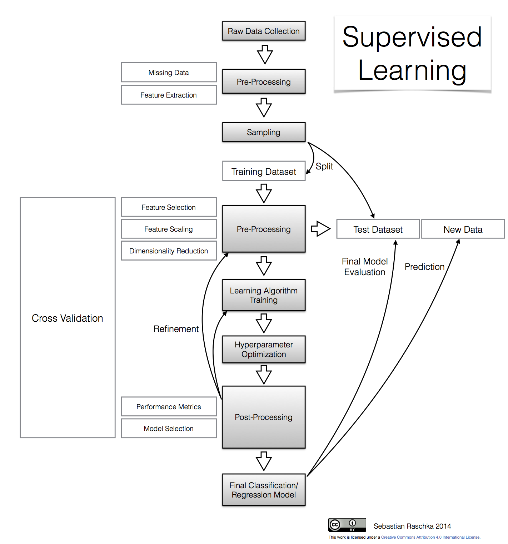

Slide 5
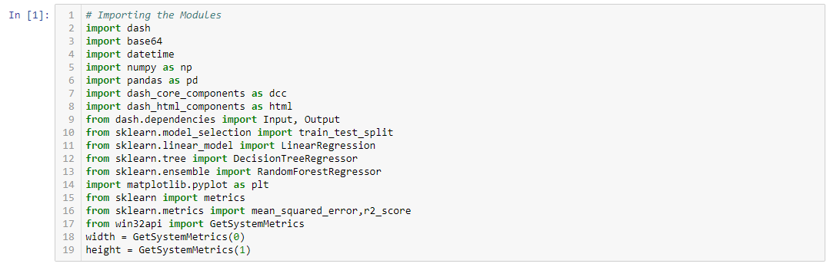
MODULES IMPORTED:-

Slide 6
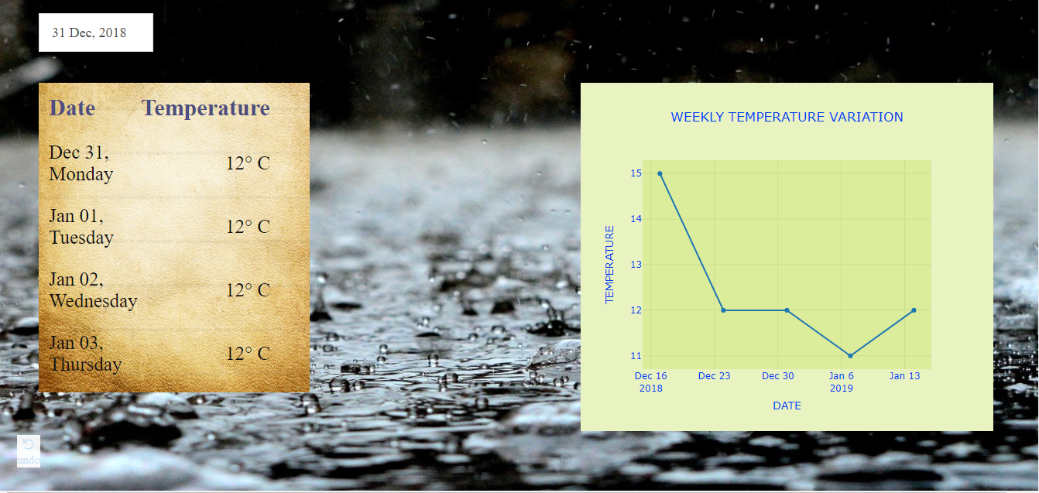
DASH WEBPAGE:-

Slide 7
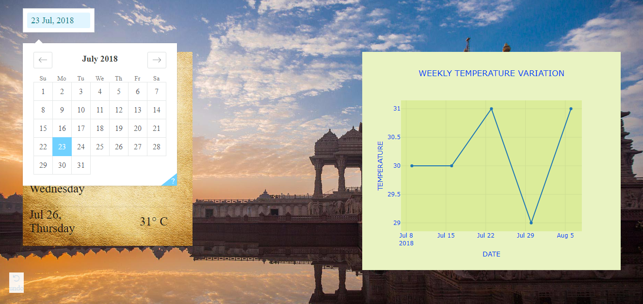
DATE PICKING

Slide 8
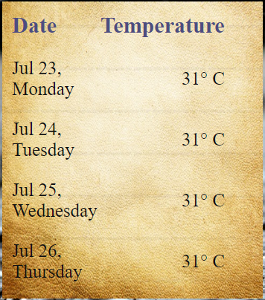
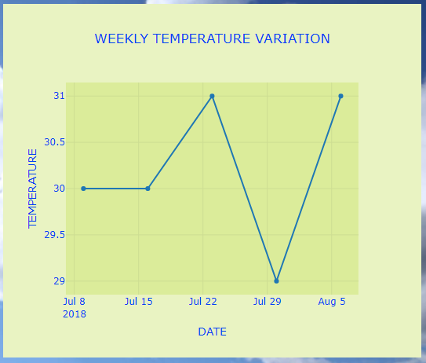
UPDATING TABLE AND GRAPH

Slide 9
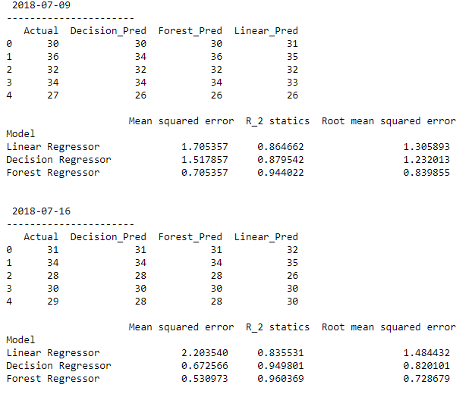
CAMPARISION BETWEEN MODELS

Slide 10
FUTURE SCOPE
The data taken was limited to only one city ,the project can be extended for more number of cities in a similar way.
The weather was predicted only by taking the data of one week for every year of respected date.
The model only predicts the temperature which can be extended for predicting the weather conditions including humidity, fog, rainfall ,etc.
The error can be minimized as well using other algorithms, and by using large number of datasets.

Slide 11

THANK YOU!!

Slide 12
Queries ?

